Slide 1

Orange Assignment
State-of-the-art pre-training for Natural Language Processing
Moaaz Youssef

Slide 2
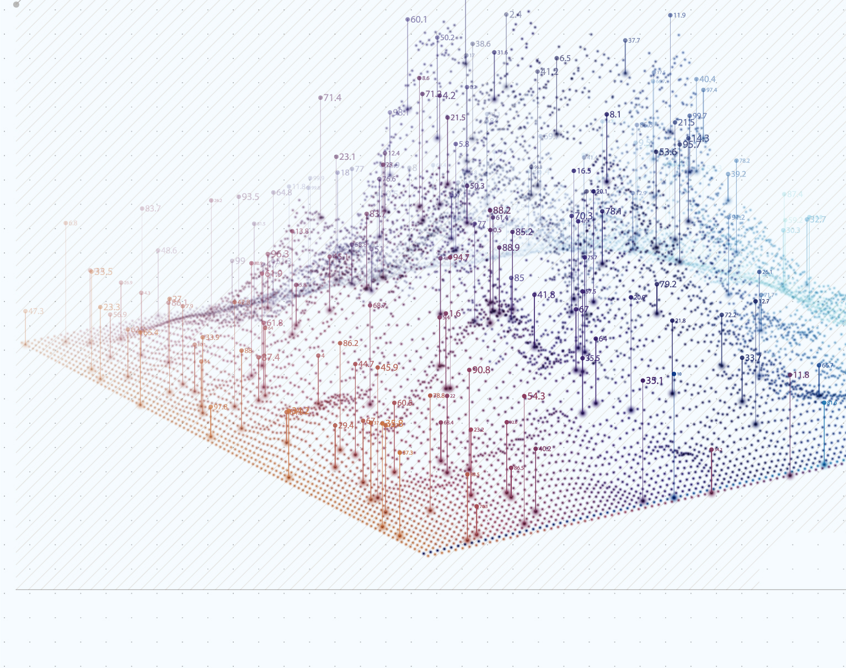
Problem Statement

Slide 3

Problem Statement
To predict, using Bert and XlNet, which category-out of five-BBC news articles fall into
Categories are sport, business, politics, entrainment and technology.
To compare the classification accuracy and time complexity of both algorithms

Slide 4

Methodology

Slide 5
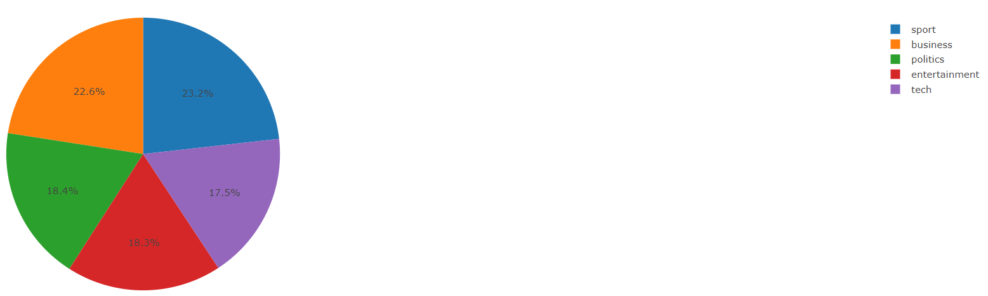
Data Preprocessing
Methodology
Data preprocessing
Model building
Model training
Model validation
Models comparison
Nulls check : There is no nulls.
Duplicates check: There is no duplicates.
Balance check : By creating pie-chart to detect categories imbalance. Categories are imbalanced, with sport category dominates the distribution.

Slide 6
Data Preprocessing
Methodology
Data preprocessing
Model building
Model training
Model validation
Models comparison
Label encoding: encode categories to one-hot-encode representation
Sample distribution: Population is assumed to have same distribution as the sample.
Data splitting: splitting the data into 80% for training and 20% for validation. Using sampling stratification method, the training dataset maintains the same imbalanced distribution as the sample.

Slide 7
Data Preprocessing
Methodology
Data preprocessing
Model building
Model training
Model validation
Models comparison
Tokenization
1- BERT tokenizer: is a WordPiece tokenizer.
Example:
BertTokenizer.from_pretrained("bert-base-uncased")
tokenizer.tokenize("I have a new GPU!")
Output: ["i", "have", "a", "new", "gp", "##u", "!"]
Notes:
Because we are considering the uncased model, the sentence was lowercased first. We can see that the words ["i", "have", "a", "new"] are present in the tokenizer’s vocabulary, but the word "gpu" is not. Consequently, the tokenizer splits "gpu" into known subwords: ["gp" and "##u"]. "##" means that the rest of the token should be attached to the previous one without space
(for decoding or reversal of the tokenization).

Slide 8
Data Preprocessing
Methodology
Data preprocessing
Model building
Model training
Model validation
Models comparison
Tokenization
2- Xlnet tokenizer: is a SentencePiece tokenizer.
Example:
tokenizer = XLNetTokenizer.from_pretrained("xlnet-base-cased")
tokenizer.tokenize("Don't you love ☺ Transformers? We sure do.")
Output:
["▁Don", “ ‘ ", "t", "▁you", "▁love", "▁", “☺", "▁", "Transform", "ers", "?", "▁We", "▁sure", "▁do", "."]
Notes:
The XLNetTokenizer uses SentencePiece for example, which is also why in the example earlier the "▁" character was included in the vocabulary. Decoding with SentencePiece is very easy since all tokens can just be concatenated and "▁" is replaced by a space.

Slide 9
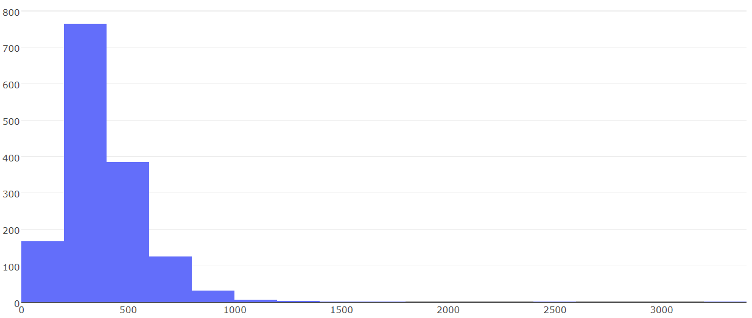
Data Preprocessing
Methodology
Data preprocessing
Model building
Model training
Model validation
Models comparison
Words distribution in articles: to determine mean and mode of number of words per article, and to choose efficient tokenization length.
Frequency
Number of words in article

Slide 10
Data Preprocessing
Methodology
Data preprocessing
Model building
Model training
Model validation
Models comparison
Model Inputs: Using tokenizer length of 512 to capture part of distribution tail, inputs ID’s and attention masks were created.
Inputs ID’s: are numerical representations of tokens building the sequences that will be used as input by the model.
Example:
tokenizer(“A Titan RTX has 24GB of VRAM”)
Output:
[101, 138, 18696, 155, 1942, 3190, 1144, 1572, 13745, 1104, 159, 9664, 2107, 102]

Slide 11
Data Preprocessing
Methodology
Data preprocessing
Model building
Model training
Model validation
Models comparison
Attention mask : is an argument indicates to the model which tokens should be attended to, and which should be padded. 1 indicates a value that should be attended to, while 0 indicates a padded value.
Tensorflow data: created tensorflow data, from inputs ID’s and attention masks, for training and evaluation to return (features, labels) pairs, as expected by keras.Model.fit

Slide 12
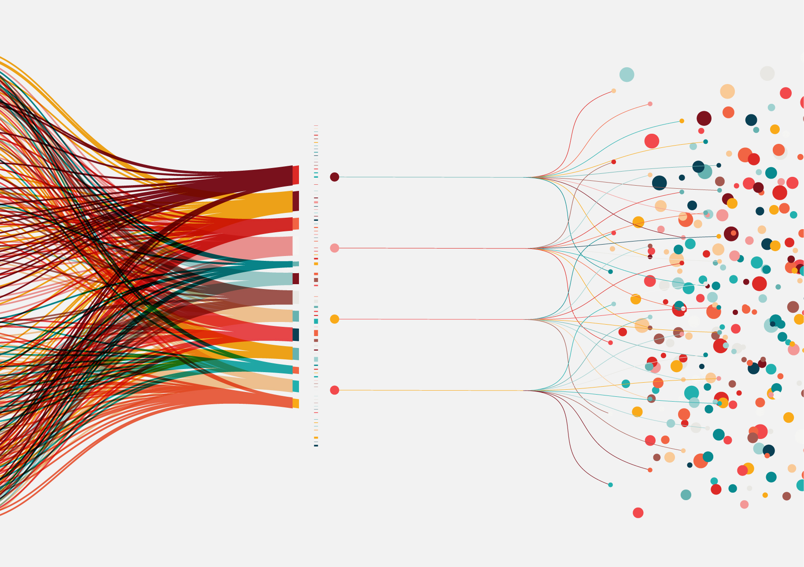
Model Building

Slide 13
Model Building
Methodology
Data preprocessing
Model building
Model training
Model validation
Models comparison
BERT blocks
Inputs layer
Input ID’s
Attention mask
Bert Base Uncased layer
12 layers (transformer blocks), 768 hidden layer, 12 attention heads and 110 million parameters
Dense layer
GELU activation function with 1024 neurons which takes pooled out as an input from Bert layer
Dropout layer
With 0.1 dropout rate to prevent overfitting

Slide 14
Model Building
Methodology
Data preprocessing
Model building
Model training
Model validation
Models comparison
BERT blocks
Dense layer
Softmax activation function which gives probability of each category as an (model output).

Slide 15
Model Building
Methodology
Data preprocessing
Model building
Model training
Model validation
Models comparison
XLNet blocks
Inputs layer:
Input ID’s
Attention mask
XLNet Base cased layer:
12 layers (transformer blocks), 768 hidden layer,12 attention heads and 110 million parameters
Dense layer:
GELU activation function with 1024 neurons which takes last hidden state as an input from XLNet layer
Dropout layer:
With 0.1 dropout rate to prevent overfitting

Slide 16
Model Building
Methodology
Data preprocessing
Model building
Model training
Model validation
Models comparison
XLNet blocks
Dense layer:
Softmax activation function which gives probability of each category (model output).

Slide 17
Model Building
Methodology
Data preprocessing
Model building
Model training
Model validation
Models comparison
Metrics
Categorical accuracy:
Calculates the percentage of predicted values that match with actual values for one-hot-encode labels
Precision:
Calculates the percentage of relevant instances among the retrieved instances
Recall:
Calculates the percentage of relevant instances that were retrieved
Loss
Opted for categorical cross-entropy loss function since the case is multi-class classification .

Slide 18
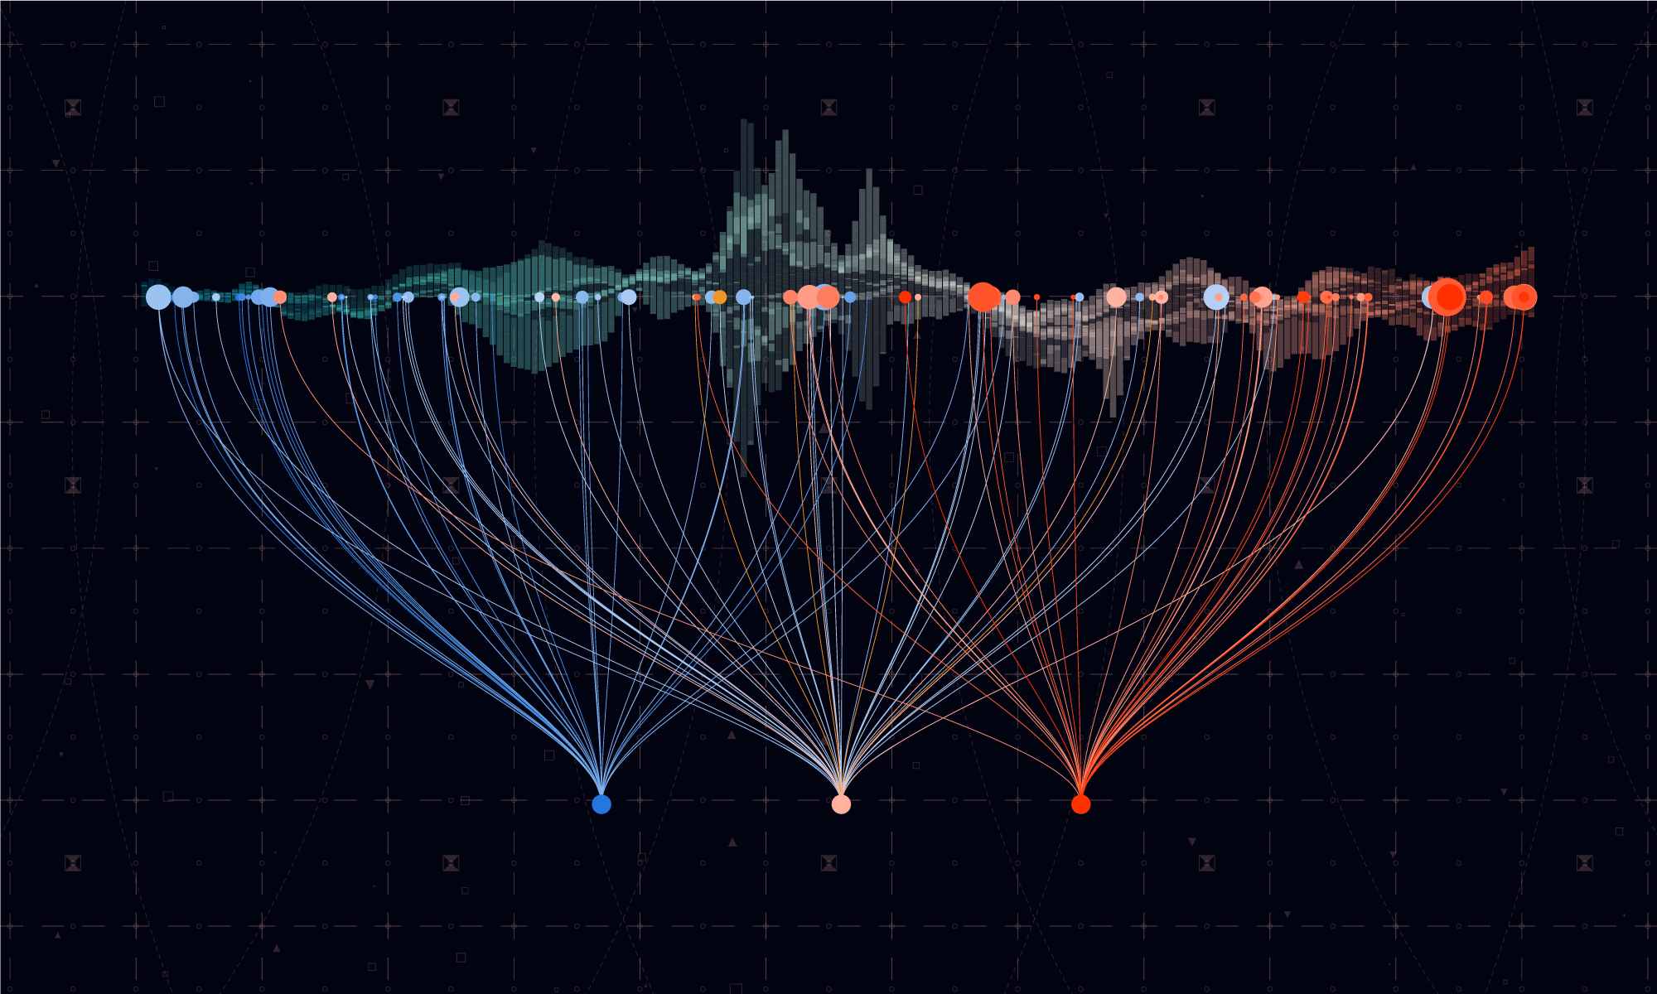
Model Training

Slide 19
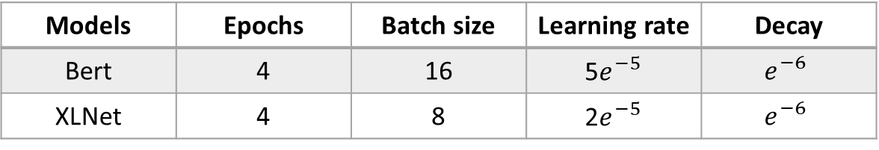
Model Training
Methodology
Data preprocessing
Model building
Model training
Model validation
Models comparison
Hyperparameters
Literature recommends the following range of hyperparamters to work well across all tasks:
Batch size: 8,16,32
Learning rate (Adam): 5e-5, 3e-5, 2e-5
Number of epochs: 2, 3,4
After trying this range of hyperparameters, the following hyperparameters yielded best metrics
However, hyperparameters tuning (Random, Grid or Bayesian search) is the recommended approach in time abundance scenarios.
Models | Epochs | Batch size | Learning rate | Decay
Bert | 4 | 16 | 5$e^{−5}$ | $$e^{−6}$$
XLNet | 4 | 8 | 2$e^{−5}$ | $$e^{−6}$$

Slide 20
Model Training
Methodology
Data preprocessing
Model building
Model training
Model validation
Models comparison
Classes weights
Classes weights tell the model to pay more attention to samples from an under-represented classes.
Calculated the classes weights to deal with imbalanced data.
Feed the classes weights dictionary as a parameter in Model.Fit method

Slide 21

Model Validation

Slide 22
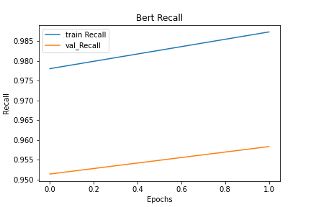
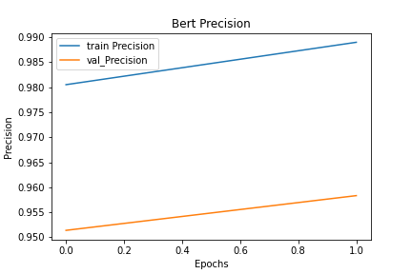
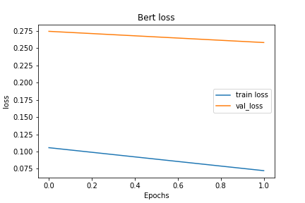
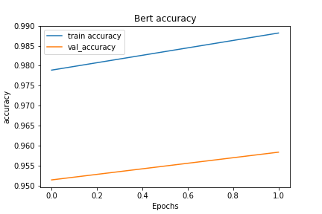
Model Validation-Bert
Methodology
Data preprocessing
Model building
Model training
Model validation
Models comparison

Slide 23
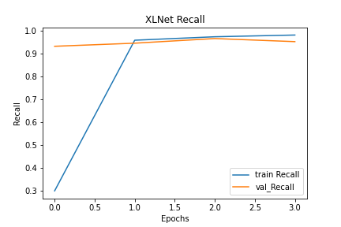
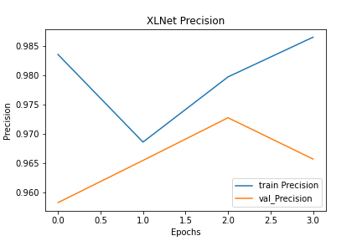
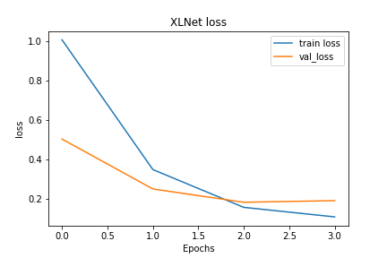
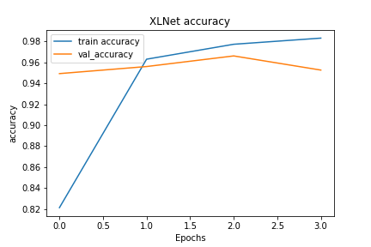
Model Validation-XLNet
Methodology
Data preprocessing
Model building
Model training
Model validation
Models comparison

Slide 24
Model Comparison
Methodology
Data preprocessing
Model building
Model training
Model validation
Models comparison
Outputs Evaluation
Bert model: Scored 97.959% accuracy on unseen data
XLNet: Scored 97.006% accuracy on unseen data
Time Complexity
Bert: Took around 58 minutes to train on Cloud Tensor Processing Units (TPUs), and around 30 minutes with early stopping.
XLNet: Took around 76 minutes to train on Cloud Tensor Processing Units (TPUs).

Slide 25

Kaggle Submission

Slide 26
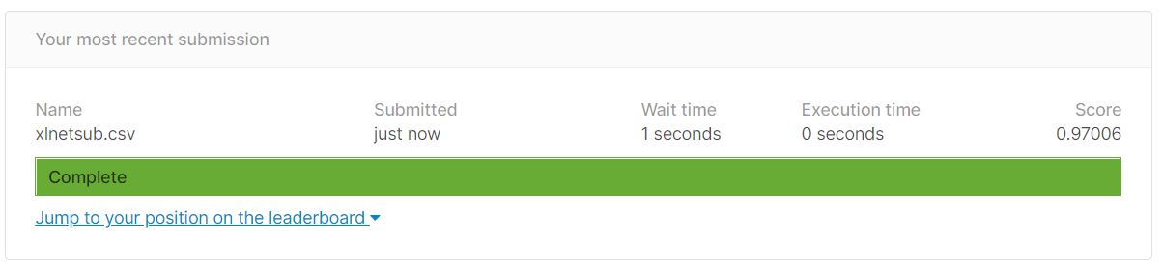
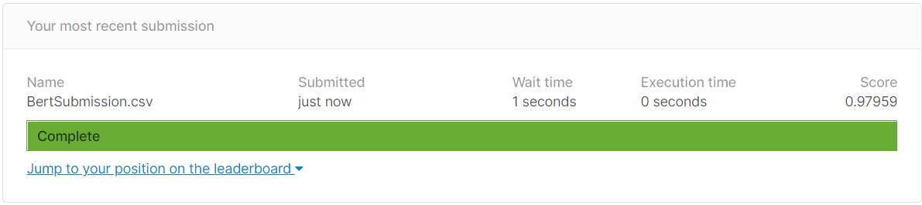
Kaggle Submission
XLNet
Bert

Slide 27

Thanks

